Slide 1
Knowledge Management for Companies- Chatbot
Prabal Ghosh
Ishfaaq illahibuccus sona
University of cote d'azur

Slide 2
Outline
Objective
Literature Review
Our Approach
Result Discussion
Conclusion

Slide 3
Objective
Original objective was to create a chatbot that is able to respond to queries from employees about a company’s documentation.
Adapted objective (suggested by Joris) is to create a fictitious document containing the profile of employees at a made up Data Science company and create a chatbot to answer queries based on those employee profiles.

Slide 4
Word Embeddings
ML models and Neural Networks cannot work directly with text data and only take numbers or vectors of numbers as input.
The text first has to be converted to numbers (vectorization) before it is fed to the model.
Word embeddings provide an efficient and dense representation of each word, where the dimension of the word vector is a hyperparameter to be specified by the user.
The higher the dimension of the embedding chosen, more details about the relationship between words can be captured.
Word embeddings represent words as vectors in such a way that similar words will have vectors which are close to each other in the vector space.
Each vector consists of floats and the values of the numbers in the vectors are learned during training.

Slide 5
Llama 2
Family of open-sourced Large Language Models released by Meta AI in 2023.
Llama 2 comes in 3 different types: 7B, 13B or 70B.
Llama 2 outperforms other open-source chat models on most benchmarks and human evaluations of helpfulness and safety chosen.
Also performs generally on the same level as closed-source models, with the exception of GPT-4 which comes up ahead.

Slide 6
LangChain
A language model integration framework.
Open-source, flexible and easy to use - one of the most widely used frameworks in NLP currently.
Offers a high-level API that simplifies the process of connecting LLMs to data sources and building complex applications.

Slide 7
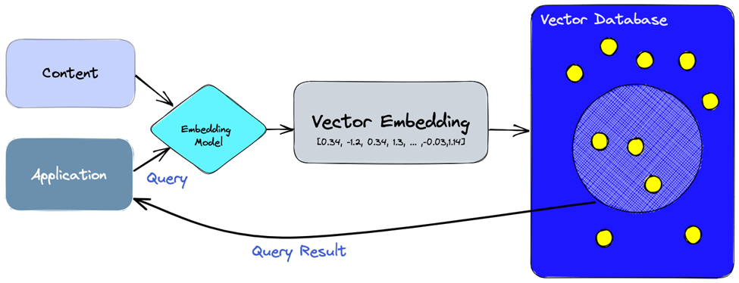
Vector Database
Quite similar to a traditional database but is much more efficient and more optimized to store vector embeddings of text data.
Also allows the efficient retrieval of the embedding vectors for similarity search during the RAG process.
Figure 1: Vector Database Process (Pinecone)

Slide 8
Potential issues with LLMs
LLMs are trained on huge amounts of data for various NLP tasks and are quite good at answering questions in a general context. They however might not perform very well in a very specific context.
However, there are cases where LLMs will invent a false answer when it doesn’t know the answer to the query.
LLMs might also provide outdated data since they are trained with data up to a certain data and therefore have no access to new data.

Slide 9
Retrieval-Augmented Generation (RAG)
RAG is a process which addresses some of the weaknesses of LLMs and help improve the quality of the responses.
During the RAG process, the LLM is provided with another database as reference and hence the LLM can generate more accurate and relevant responses in that domain as it uses both its training data and the new relevant data it has been provided as context to answer the queries.
This process happens without needing to retrain the model and is therefore very cost-efficient

Slide 10
RAG Process
Provide the external data source: the LLM will infer from this data to generate the response.
Create vector embeddings for the external data – embeddings stored in the vector database.
Next step is to do a relevancy search - The query from the user is also converted to a numerical representation and this is matched with the embeddings of the external data stored in the vector DB. The LLM will then retrieve the appropriate documentation from the vector DB based on the similarity score.
The LLM will then combine the query from the user and the relevant retrieved data from the vector database and this will serve as context to help the LLM generate more accurate responses.

Slide 11
requirements
# local package
ctransformers==0.2.5
sentence-transformers==2.2.2
pinecone-client== 2.4.0
langchain==0.0.225
pypdf
python

Slide 12
Our approach
The data used for this case study is generated from ChatGPT 3.5 and the Large Language Model (LLM) chosen is Llama 2 (7B tokens) from Meta. The data is about the profile of five fictitious employees working at a Data Science company. The data is in the form of a PDF file and will be extracted from the file and split into a bunch of chunks.
We will then use an embedding model to convert the word in each chunk of text into numerical vectors. The embedding model (model name: sentence-transformers/all-MiniLM-L6-v2) chosen is obtained from HuggingFace and converts each word into a vector of 384 dimensions.
These embedding vectors will then be stored into a vector database. The vector database we have chosen is Pinecone, which provides a free functionality to store those vectors.
When a query is asked by the user, a similarity search will be performed between the query asked and the embedding vectors stored in the vector database. The relevant information pertaining to the query will then be retrieved from the database.
We will then use the relevant information and the LLM to provide the most relevant answer to the query.

Slide 13
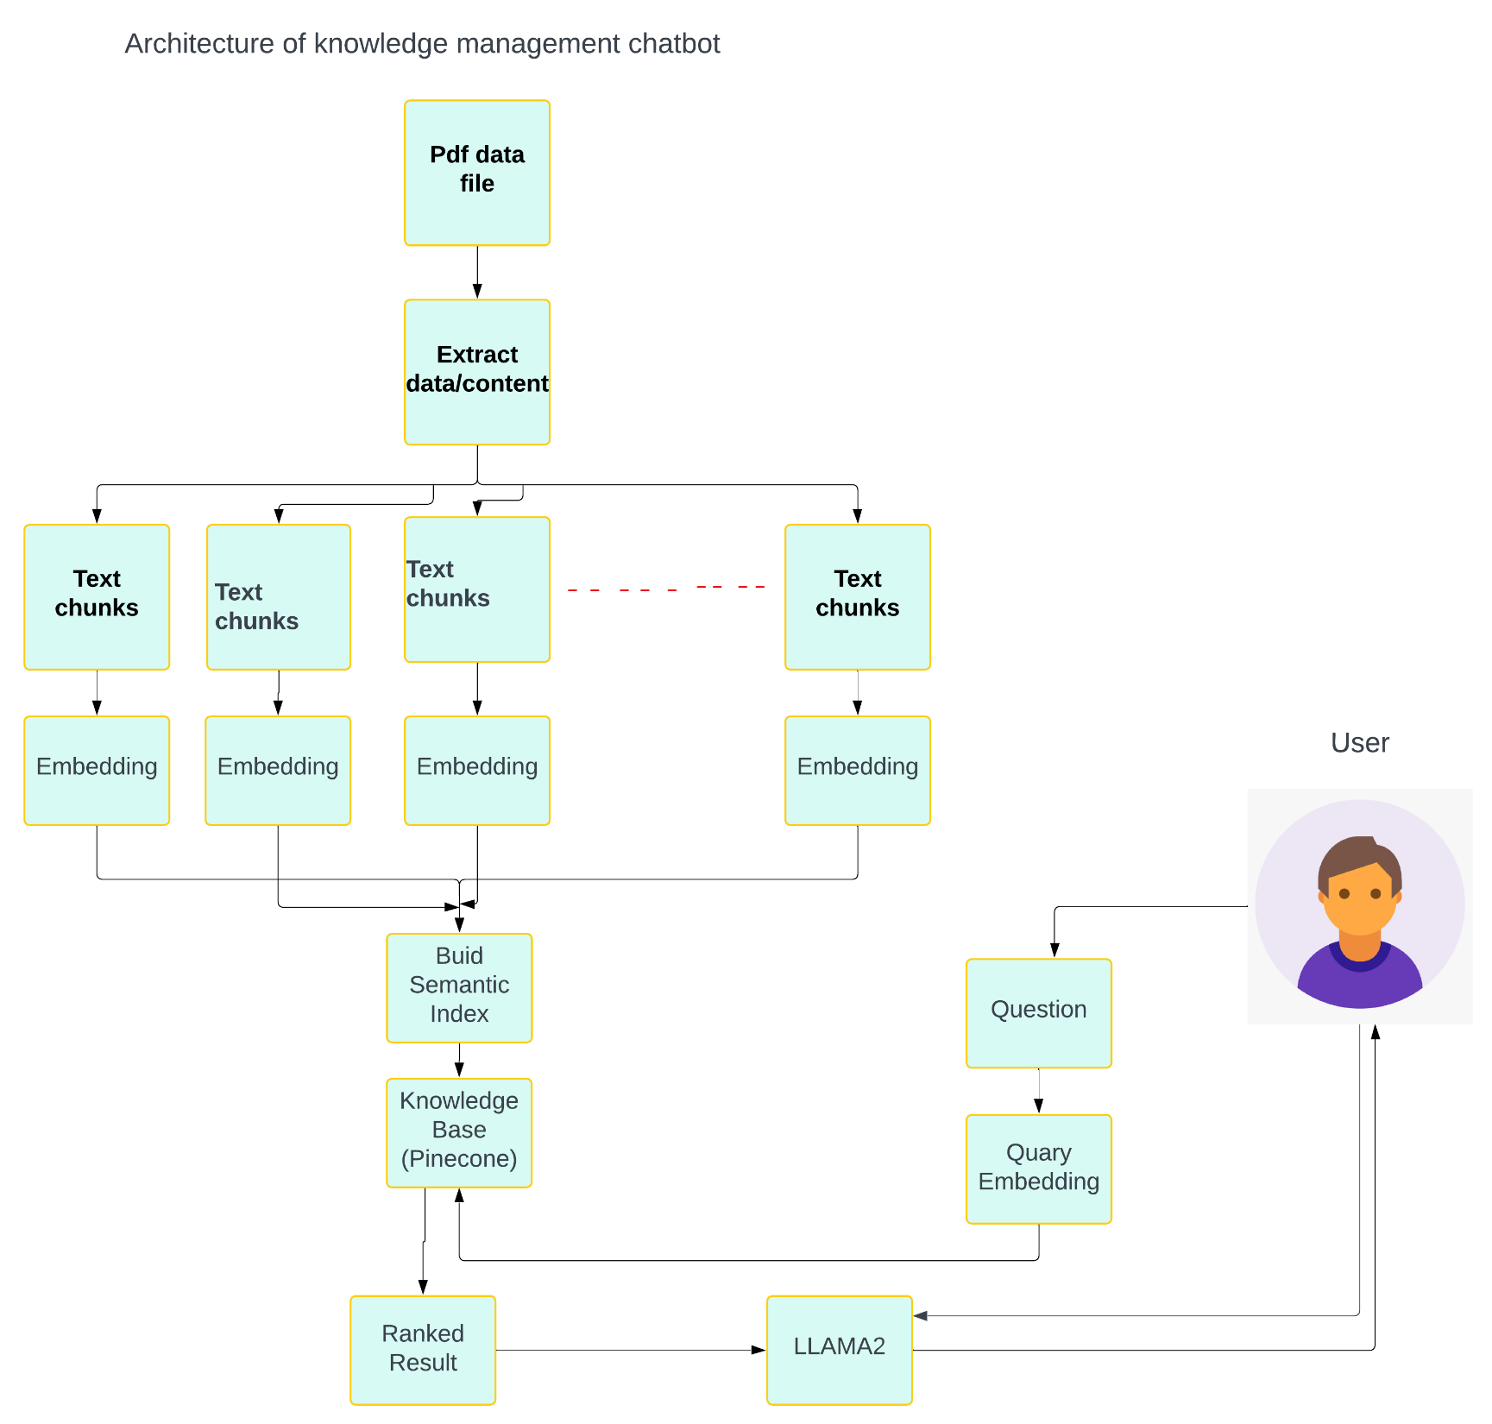
Architecture
The data is in PDF format, necessitating extraction of its content.
We divide the extracted data into different text chunks.
Since the context window size for LLAMA2 is 4096 tokens, chunks are essential if the corpus exceeds this size.
Each text chunk has a size of 200 words, with a specified overlap of 10 words between adjacent chunks.
We create embeddings for each chunk to convert them into numerical representations.
These embeddings are then combined to build a semantic index.
The vectors obtained from the embeddings are stored in a vector database, using Pinecone as the remote database.
Alternatively, Cromadb can be used as a local vector database.
When a user query is received, a similarity search is conducted between the query and the embedding vectors stored in the vector database.
The results are ranked based on similarity to the query.
Relevant information related to the query is retrieved from the database.
LLM2 is integrated into the system to filter the exact answer from the ranked results.
The response generated by LLM2 is then sent to the user.

Slide 14
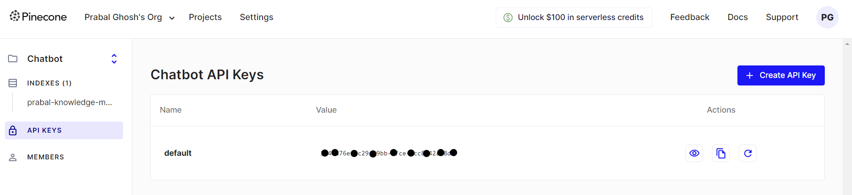
pinecone

Slide 15
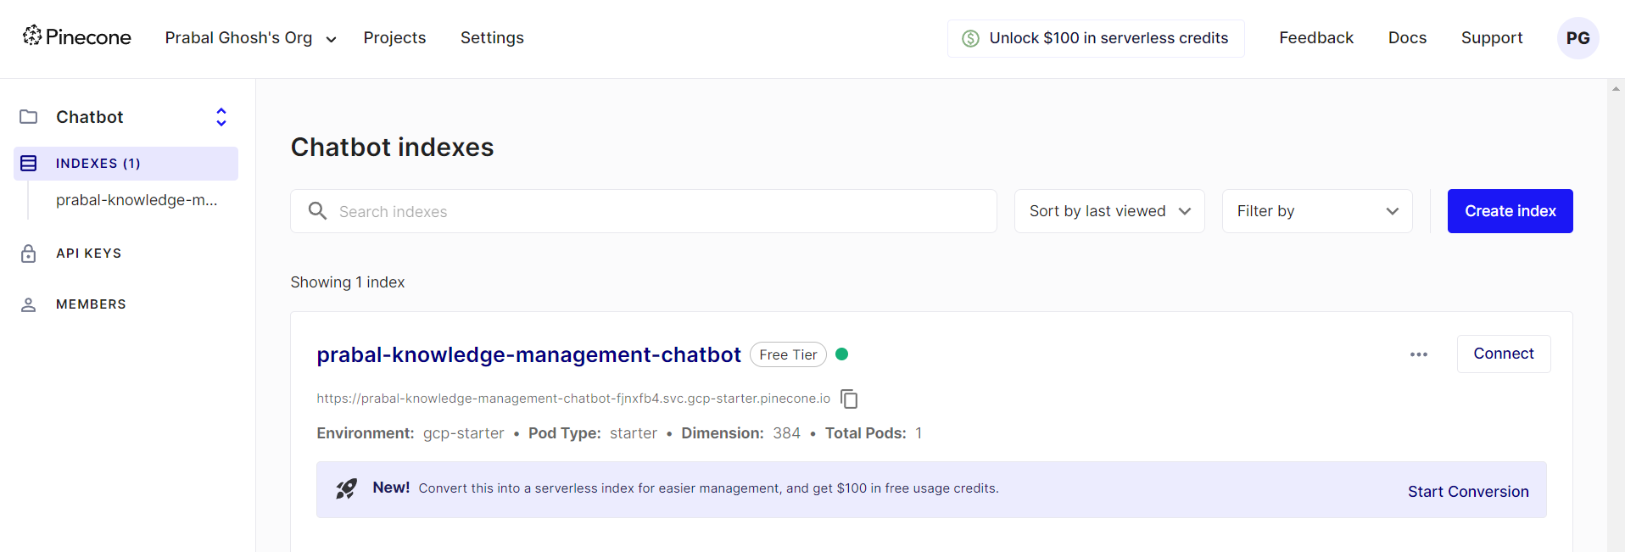
pinecone
https://app.pinecone.io/organizations/-NqnyBGN5xjg9QtzRUne/projects/d6915111-277f-45a6-be03-131304643921/indexes/prabal-knowledge-management-chatbot/browser

Slide 16
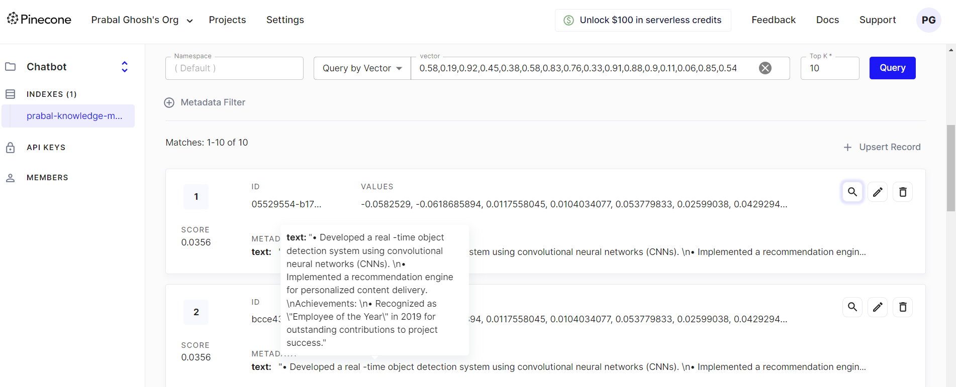
pinecone

Slide 17
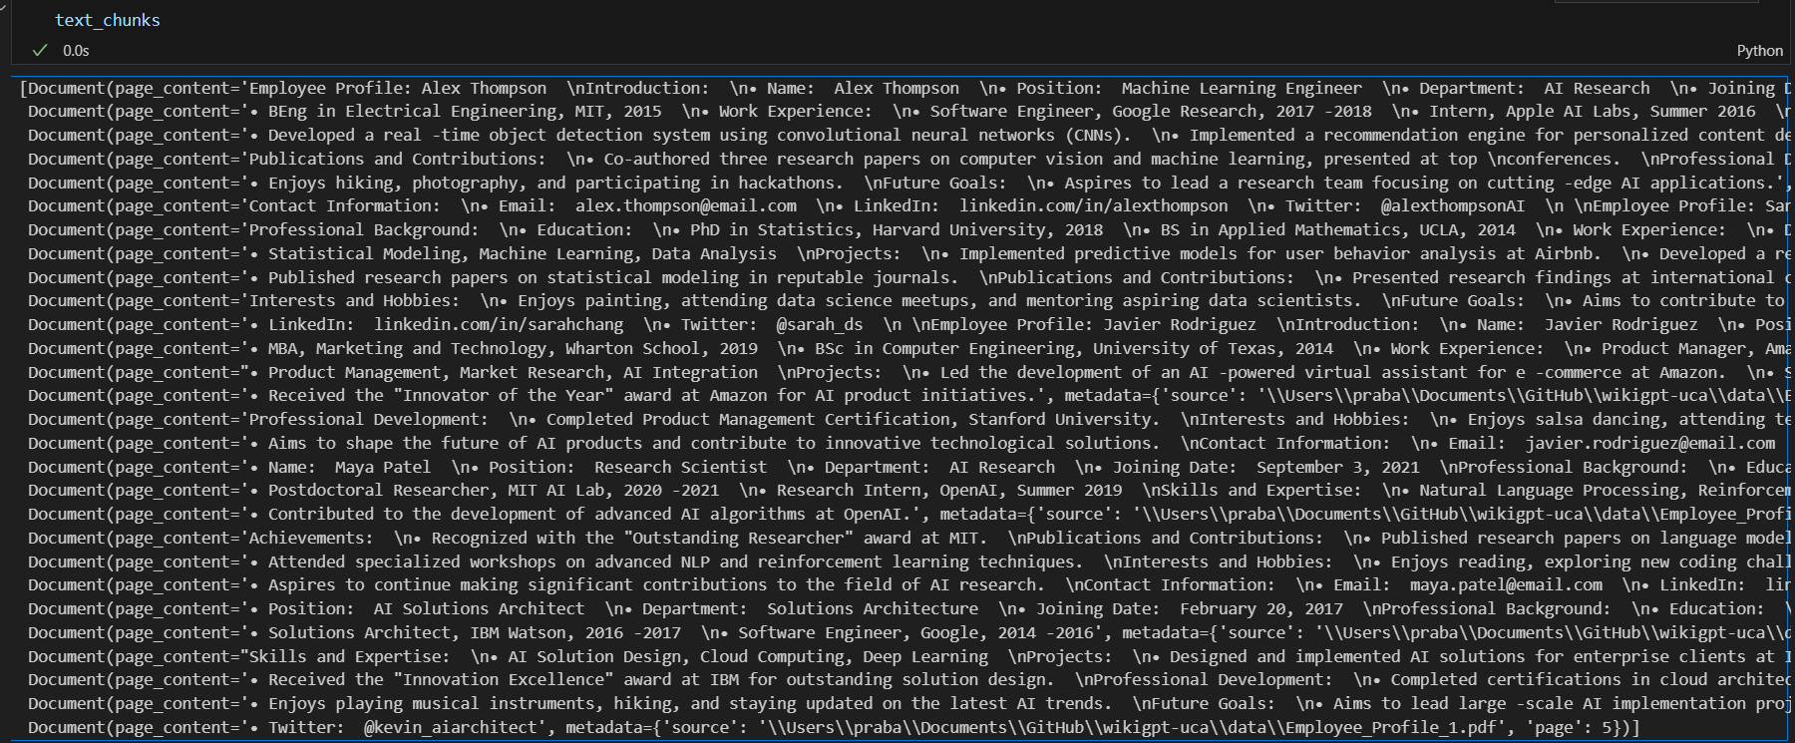
Code Explaination
#Create text chunks
class Split_text():
def __init__(self, loaded_data):
self.loaded_data = loaded_data
def text_split(self):
text_splitter = RecursiveCharacterTextSplitter(chunk_size = 300, chunk_overlap = 10)
chunks = text_splitter.split_documents(self.loaded_data)
return chunks

Slide 18
Code Explaination
#download embedding model
def download_hugging_face_embeddings():
embeddings = HuggingFaceEmbeddings(model_name="sentence-transformers/all-MiniLM-L6-v2")
return embeddings
#Initializing the Pinecone
pc =pinecone.init(api_key=API_KEY,
environment=API_ENV)
#Creating Embeddings for Each of The Text Chunks & storing
Pinecone.from_texts(list_chunks, text_embeddings, index_name=index_name)
https://huggingface.co/sentence-transformers/all-MiniLM-L6-v2

Slide 19
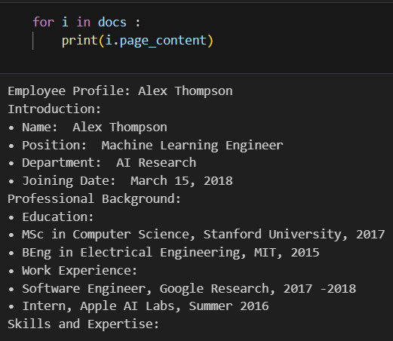
Code Explaination
#If we already have an index we can load it like this
retrived_text = Pinecone.from_existing_index(index_name, text_embeddings)
query = "Who is Alex Thompson"
docs = retrived_text.similarity_search(query, k=1)
print("Result", docs)

Slide 20
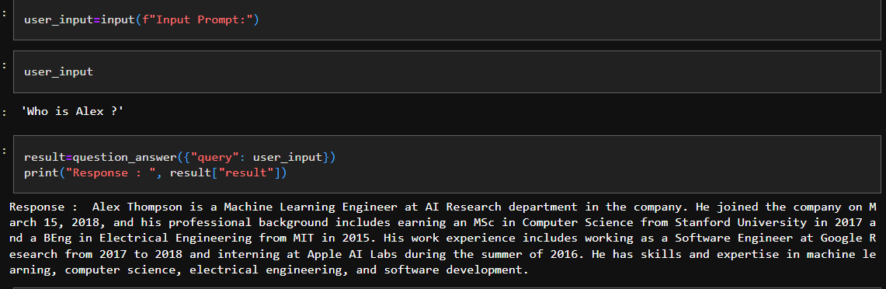
Final Result
llm=CTransformers(model="../model/llama-2-7b-chat.ggmlv3.q4_0.bin",
model_type="llama",
config={'max_new_tokens':256})
question_answer=RetrievalQA.from_chain_type(
llm=llm,
chain_type="stuff",
retriever=docsearch.as_retriever(search_kwargs={'k': 1}),
return_source_documents=True,
chain_type_kwargs=chain_type_kwargs)

Slide 21
Conclusion
Our chatbot is working perfectly.
Next we are planning to add interface using python flask framework.

Slide 22
Thank You

